Slide 1

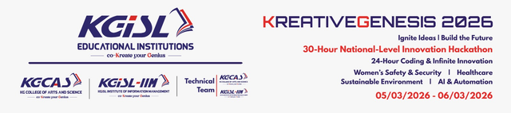

CP1
KREATIVE GENESIS 2026
TITLE PAGE
PROBLEM STATEMENT TITLE : AI-Based Medication Adherence Tracker
DOMAIN NAME : Health Care Technology
PROBLEM STATEMENT: AI-Based Medication Adherence Tracker
TEAM-ID: KGH224
TEAM NAME: Tech Tonic

Slide 2

CP1
AI-Based Medication Adherence Tracker
What Problem Are We Solving?
Medication non-adherence is a major global healthcare problem where patients forget, skip, or take incorrect medicines.
Who Faces This Problem?
Elderly people living alone
Patients with chronic diseases like diabetes and hypertension
People who take multiple medicines daily
Why Is This Important?
Sometimes patients simply forget, sometimes they confuse medicines, and Sometimes they sollow wrong medicine that causes severe side effects and sometimes fetal causes.
Current reminder solutions like phone alarms or pill boxes are not reliable enough for elderly users.

Slide 3
CP1
AI-Based Medication Adherence Tracker
Our Idea
We designed an AI-Based Medication Adherence Tracker, a smart reminder device that ensures users never miss their medicine again.
Instead of just a boring alarm, our system acts more like a small assistant.
What Our System Does
When it is time to take medicine, the device:
Displays the medicine name and time
Gives a voice reminder
Repeats the alert until the medicine is taken
Why Our Solution Is Different
Most reminder systems only give simple alarms.
Our system improves this by using:
Voice reminders
Visual display guidance
AI-based scheduling support
IoT connectivity for future monitoring

Slide 4
CP1
AI-Based Medication Adherence Tracker
System Architecture
Our system consists of three main parts.
1:Hardware Layer
This is the physical device.
Main components include:
ESP32 Microcontroller – the brain of the system
OLED Display – shows medicine name and time
Voice Module + Speaker – gives voice reminders
Real Time Clock (RTC) – keeps accurate timing
3:AI / Cloud Layer
This layer allows future expansion such as:
Smart reminder adjustments
Remote monitoring
Data storage
2:Software Layer
This layer manages the logic of the system:
Medication scheduling
Reminder triggering
Data processing
All these components communicate together to ensure accurate and reliable reminders. !!

Slide 5
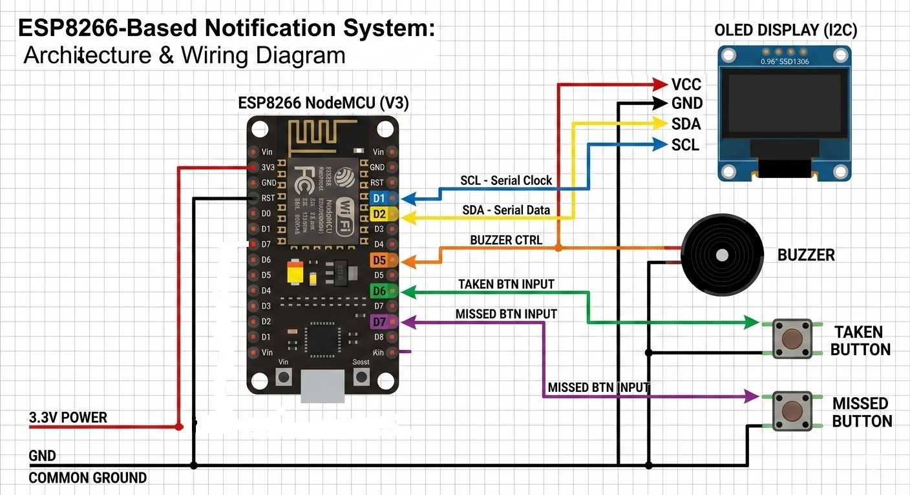
CP1
AI-Based Medication Adherence Tracker
WORK FLOW
User Input
↓
Medicine Schedule Stored
↓
RTC Time Monitoring
↓
Time Match Detected
↓
Reminder Trigger
(Display + Voice Alert)
↓
User Takes Medicine
↓
Confirmation / Reminder Stops
↓
System Logs Activity
AI in the workflow
Reminder Trigger
↓
AI analyzes adherence pattern
↓
Adjusts reminder frequency

Slide 6
CP1
AI-Based Medication Adherence Tracker
Main Users
Patients : They interact with the system by receiving reminders and taking medicines accordingly.
Secondary Users:
Caregivers or family members
External Services
In future versions, the system can integrate with:
AI services
Cloud storage
Healthcare monitoring systems
Devices Involved
Our prototype includes:
ESP32 controller
Display module
Voice reminder system
Speaker or buzzer

Slide 7
CP1
AI-Based Medication Adherence Tracker
How Data Moves in the System
The user enters medicine information.
The system stores the data and monitors time using the RTC module.
When the scheduled time arrives:
ESP32 triggers the reminder
Display shows the medicine name
Voice module plays the reminder
The reminder continues until the user responds.
Component Interaction
Component | Purpose
ESP32 | Controls the entire system
RTC Module | Maintains accurate timing
OLED Display | Shows medicine information
Voice Module | Plays reminder audio
Speaker | Outputs sound

